Slide 1
INVESTMENT ASSIGNMENT
SUBMISSION
Name: Parikshit Singh Tomar
Mobile No: 9910112332
Address: Delhi
Date : 24 Oct 2020

Slide 2
Agenda: Identify best sectors, countries, and a suitable investment type for Sparx Fund Assest Management Company
Constraints for Investments
Investment start from 5 to 15 million USD per round
Investment should be English speaking countries only.
Invest where most other investors are investing.

Slide 3
Exploratory Data Analysis
Venture
Seed,
Angel
Find Top 9 English
Speacking Country
USA,GBR
IND etc
Find Best
Investment Type
Find Top 9 English
Speacking Country
Finding Best Sector
For invesment
Start
Select Top
3 Sectors
Analysis for
Top 3 Countries
USA,GBR,IND
Investment
Count Ranked
1,2,3
Most funded
Ranked
1,2,3
Investment
Count Ranked
Sectorwise
Most funded
Ranked
Sector wise

Slide 4
Best Investment type after data analysis of companies and rounds2 data set
Venture : 558487.96Million USD
Private Equity: 126978.91 Million USD
Seed: 15554.78 Million USD
Angel : 4235.95 Million USD

Slide 5
<Country Analysis top 9 after merging data set companies varaiables to rounds2 names master >
USA
CHN
GBR
IND
CAN
FRA
ISR
DEU
JPN
<Country Analysis top 9 after merging data set companies varaiables to rounds2 names master >

Slide 6
<Top invested sectors with respect to top selected countries>
Ranked 1 -:
USA : Others
GBR: Others
INA: Others
Ranked 2 -:
USA: Cleantech / Semiconductors
GRB: Cleantech / Semiconductors
INA: News, Search and Messaging
Ranked 3 -:
USA : Social, Finance, Analytics, Advertising
GBR : Social, Finance, Analytics, Advertising
INA : Entertainment

Slide 7
<Graph Representation of Investment Type with respect to amount/counts of investment in millions >
Investment type with respect to invested counts
Investment type with respect to invested amounts (million USD)

Slide 8
<Top 9 Countries Investment wise>
Leaveing china as it is not a official english speaking country. Only three country are on top USA,
GRB and IND.

Slide 9
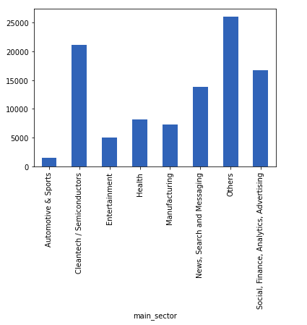
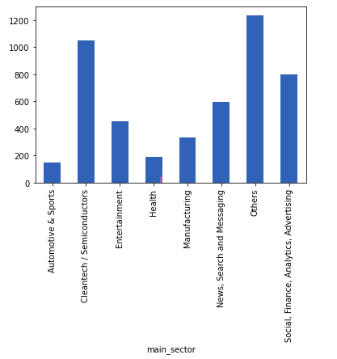
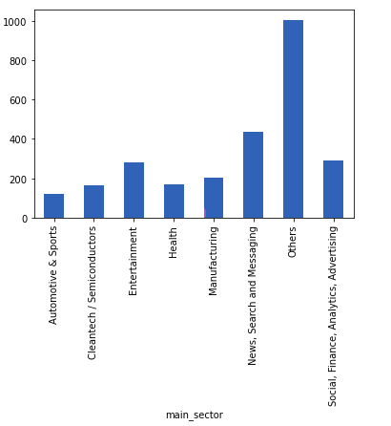
Main Sectorwise investment for Different Countries
Main Sectorwise investment for Country USA
Main Sectorwise investment for Country GRB
Main Sectorwise investment for Country India(IND)

Slide 10
<Conclusions>
-: Most invested sector is Venture which suits the constraints of investment 5Million to 15 Million USD
-: We have total top 9 countries which are heavily invested from this set we can select USA, GRB and IND as a option to invest amounts as these are only official english speaking countries and best suitable for communication.
-: “OTHERS” are the most heavily invested sector and ranked 1, while electorincs/semiconductors ranked 2 for USA and GBR while for India(INA)

